Slide 1
Case Study for Yulu -Data Analyst (Intern)
Problem statement 1:
Demand- Supply:
Yulu Bikes needs to be moved between the zones from low demand to zones of high demand. How
do we plan our truck movements? A day can be broken into multiple time slots.

Slide 2
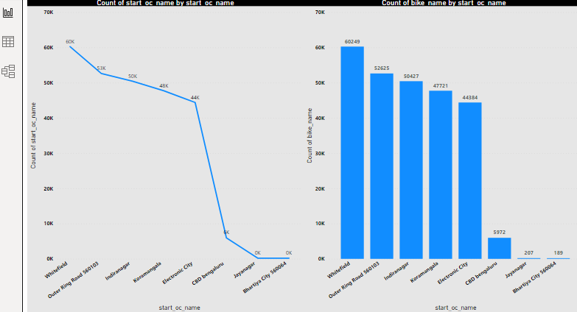
1. Top performing zones and underperforming zones and how do you decide that?
INSIGHTS:
By Observing the graphs we can decide that Whitefield ,ORR, Indiranagar, Koramangala and electronic city are the Top Performing Zones and Underperforming Zones are Cbd , Jayanagar , Bhartiya city
This can be decided by considering total number of repeated pickup at zones and total no of times the bike is picked at the zones
We have to make sure we keep the most bikes at top performing zones and less bikes at Under performing zones.

Slide 3
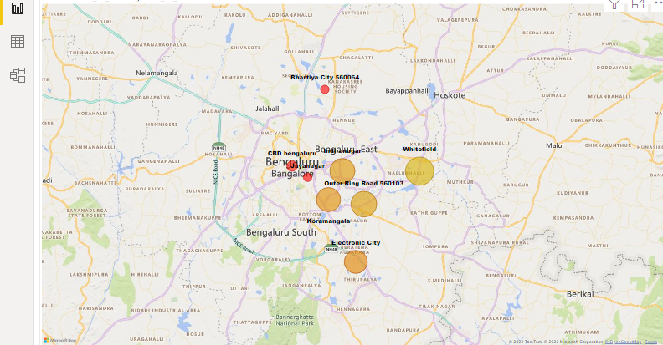
Yulu Zones By count of pickups
As per the map visual bigger the size of the bubble highest pickups in that zone
Whitefield, OTT , Indira Nagar , Kormagala and Electronic city are the zones where the bikes are utilized maximum
Jayanagar , CBD , Bhartiya city are the zones where the bikes are utilized minimum

Slide 4
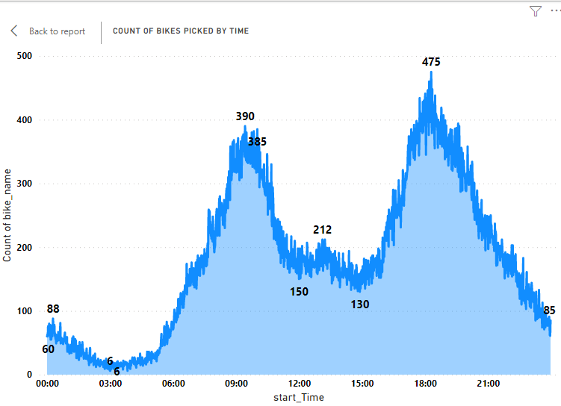
Insights
Bike Booking Starts Increasing from Morning 5am to 10am with a range of 210
From 10 am – 11:30 am there is quite decrease in bookings
From 11:30 am – 4 pm , the bookings are constant with a range of 181
There is Quick rise in the Bookings from 4pm – 8pm with highest in the day of 475 and range of 327
From 8pm there is gradual decrease till the end of the day with a range of 280

Slide 5
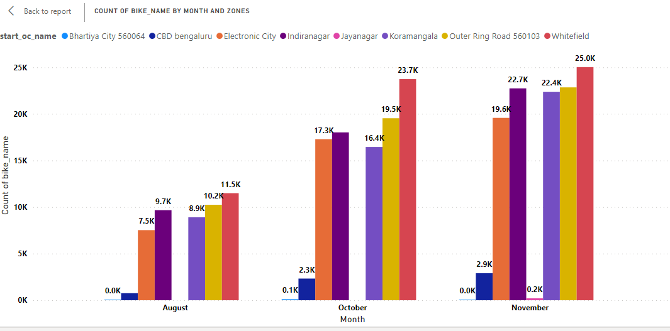
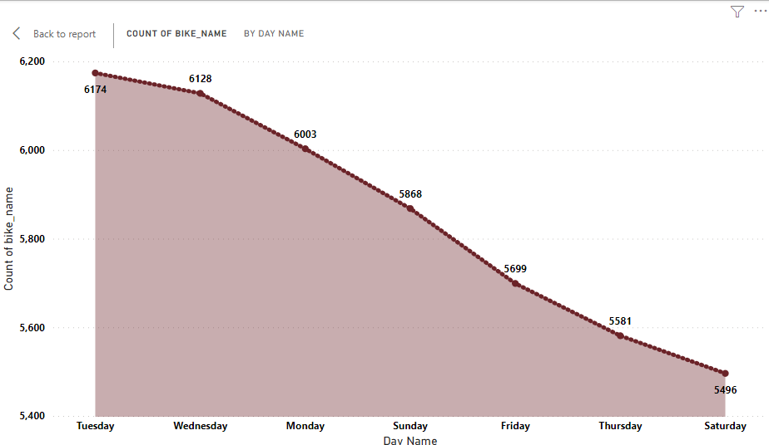
The pickups are increasing month on month from august to November, it is nice progress for any company
Monday, Tuesday , Wednesday and sundays are having high demand comparing to other days
There is no increase in the bookings in the zones of Bhartiya city and Jayanagar, these zones to be taken care

Slide 6
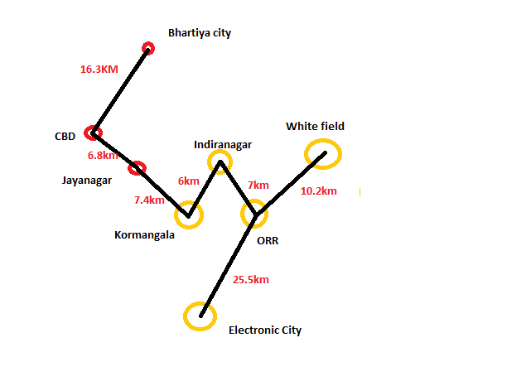
2. How do we decide the route for our trucks to make sure maximum utilisation of bikes.
We must consider many factors like zones , time zone , and day name.
Considering the zones- yellow ones should be focused first covering the red ones
Considering the time zone- before 5 am , between 10am-4pm and After 8 pm is the best time for truck movements.(reference Slide 4)
Considering the day name – Thursdays , Fridays ,Saturdays and sundays are to be considered for effective truck movements (reference Slide 5)

Slide 7
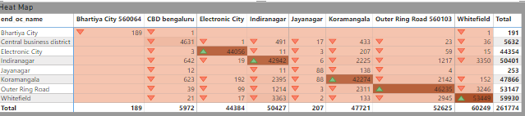
3. What basic parameters would be considered to build a ride prediction model.
AS per the above Heatmap we should consider Zones as one parameter to use the truck movement effictively

Slide 8
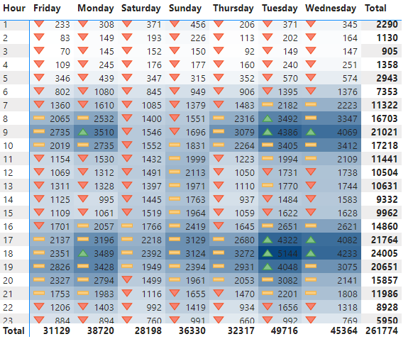
TIME and Day name are another two parameters to be considered for effective Truck Movements

Slide 9
4. Change in the usage pattern over time and days.
CONCLUSTION:
For effective and maximum utilization of bikes, the truck movements should be:
The trucks should start focusing on the Whitefield first where there is high demand and it is to be checked properly wether the bikes are in proper condition , check with the battery percentages and other important services to be taken care .
Next the truck has to move to Outer ring road which is 10.2 km from white field and necessary conditioning actions to be done
While covering these two zones another truck has to be complete its servicing in Electronic city
After Covering ORR the truck has to go to Indira Nagar followed by kormangala , Jayanagar , CBD and finally Bhartiya city
All these movements of truck and servicing part should be done anytime before 5 am , between 10am-4pm and After 8 pm so that it wont clash the users and the field mans during the day
Mondays , Tuesdays , wednesdays and sundays are the days the maximum usage of bikes so these days there should be no shortage of bikes and low battery issues and other servicing problems for the users.

